Slide 1

TIKITAKA GAME Andrea Zambetti Mattia Visini

Slide 2
INTRODUZIONE AL GIOCO

Slide 3
FUNZIONALITA’ PRINCIPALI
01.
02.
03.
04.
Multiplayer Online
Physical Collisions
Client-Server & Thread
Gestione collisioni
Attractive GUI
Sound Effect
Java Swing
Suoni generali

Slide 4
OUR PHILOSOPHY
Jupiter
Venus
Saturn
It’s the biggest planet
in the Solar System
Venus has a beautiful name, but it’s hot
Saturn is a gas giant with several rings

Slide 5
OUR SERVICES
Mercury
Venus
Mars
Saturn
Neptune
Jupiter
Mercury is the closest planet to the Sun
Venus has a beautiful name, but it’s terribly hot
Despite being red, Mars is actually cold
Saturn is a gas giant with several rings
Neptune is the farthest planet from the Sun
It’s the biggest planet in
the Solar System

Slide 6
BEST SELLERS
TikiTaka
Fifa
SoccerStar
80%
90%
75%
It’s the biggest planet in the Solar System
Venus is the second planet from the Sun
Saturn is a gas giant with several rings

Slide 7
AWESOME WORDS

Slide 8
CUSTOMER TESTIMONIALS
Helena James
John Patterson
“Mercury is the closest
planet to the Sun and the
smallest one in the Solar
System—it’s only a bit
larger than the Moon”
“Despite being red, Mars is
a cold place, not hot. The
planet is full of iron oxide
dust, which gives the
planet its reddish cast”

Slide 9
OUR STRENGTHS
Loyalty
Efficiency
Reliability
Commitment
Neptune is the farthest planet from the Sun. It’s really cold there
Despite being red, Mars is a very cold place. It’s full of iron oxide dust
Mercury is the closest planet to the Sun and also the smallest one
Jupiter is a gas giant and the biggest planet in the Solar System

Slide 10
CUSTOMER PROFILE
Gender
Occupation
Age
Jupiter is the biggest planet
Mercury is the smallest planet
Despite being red, Mars is cold
Men
Women
70%
75%
25%
25 - 35
20%
36 - 45
10%
21-30
46 - 55
31-50

Slide 11
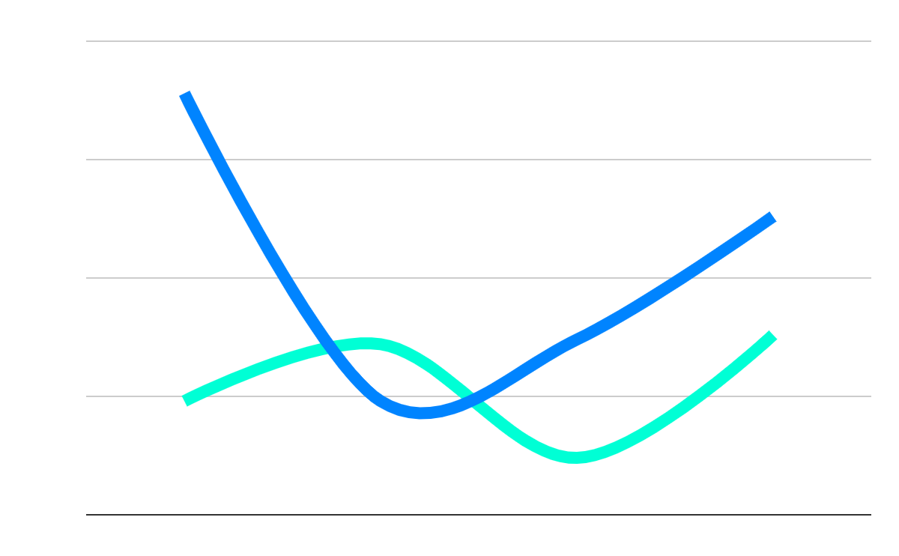
OUR GROWTH
20,000
Expected income for next year
100
New employees next year
1990
2000
2010
2020
Follow the link in the graph to modify its data and then paste the new one here. For more info, click here

Slide 12
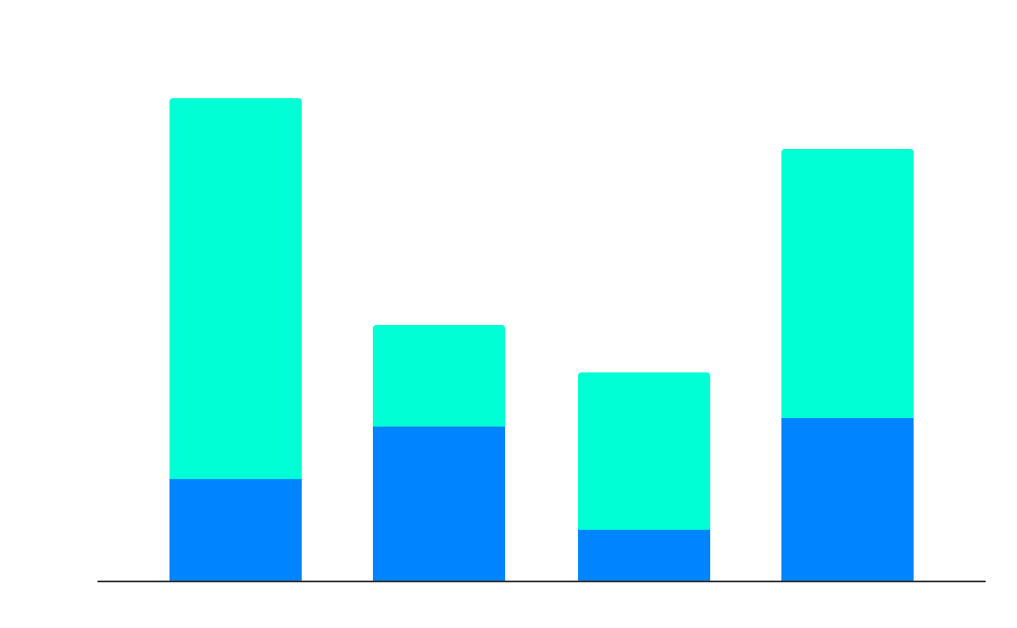
OUR NUMBERS
25%
Sales
Budget
80%
People
Mercury
Jupiter
50%
Market
50%
Efficiency
1990
2000
2010
2020
$28.87
30 days
40 shops
77 units
Avg. price per unit
Avg. days on market
Retailers
Remaining inventory
Follow the link in the graph to modify its data and then paste the new one here. For more info, click here

Slide 13

MULTIMEDIA
You can replace the image on the screen with your own work
Or you can replace the image on the screen with another image
Just right-click on it and select “Replace image”

Slide 14
FUTURE PROJECTS
Project 1
Project 3
Venus is the second planet from the Sun
Mercury is the closest planet to the Sun
01
02
03
04
Project 2
Project 4
Despite being red, Mars is a cold place
Jupiter is the biggest planet of them all

Slide 15
AWARDS
Venus
Mercury
Mars
Venus is the second planet from the Sun. It’s hot there
Mercury is the closest planet to the Sun and the smallest one
Despite being red, Mars is actually a very cold place

Slide 16
THANKS
Do you have any questions?
addyouremail@freepik.com +91 620 421 88 yourcompany.com
Please keep this slide for attribution

